Slide 1



Branding Yourself for a Dream Job
The Modern Resume
Steve Jones (@way0utwest)
Editor, SQLServerCentral
Database Weekly
Red Gate Software
www.themodernresume.com

Slide 2
Agenda
Why Build a Brand?
Resume Tips
Practical Tips
  Social Networking
  Volunteering
  Leadership
  Blogging
  Authoring
  Speaking
Recruiters

Slide 3
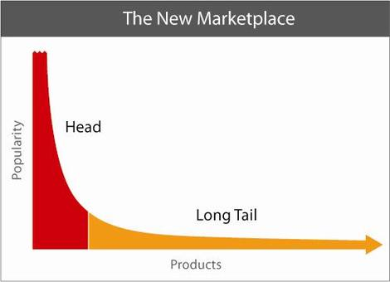
Long Tail

Slide 4
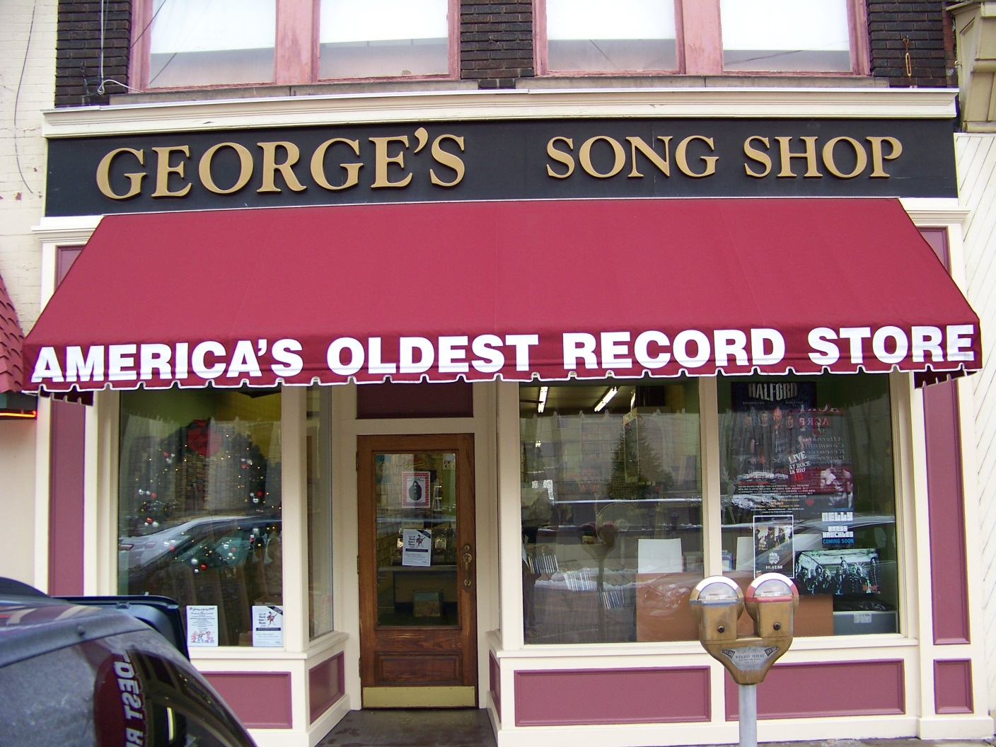

Slide 5
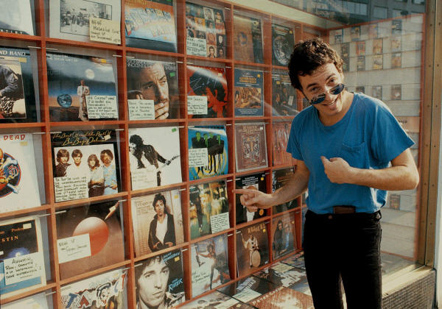

Slide 6


Slide 7
Employer Desire
Potential Employees

Slide 8

Employer Desire
Potential Employees

Slide 9

Employer Desire
Potential Employees
Potential Employees

Slide 10

Employer Desire
Potential Employees
Potential Employees

Slide 11


Slide 12
Standing Out
Humility is good, except
  When looking for a job
  Trying to get a promotion
  Trying to keep a job

Slide 13


Slide 14
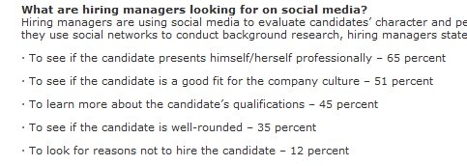
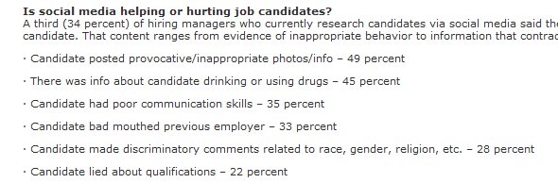
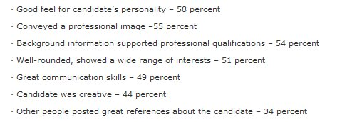

Slide 15
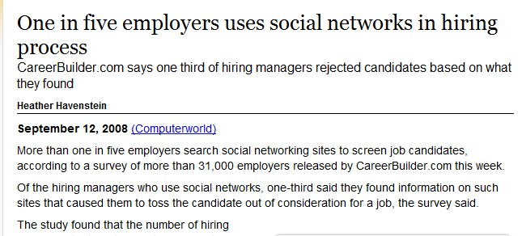
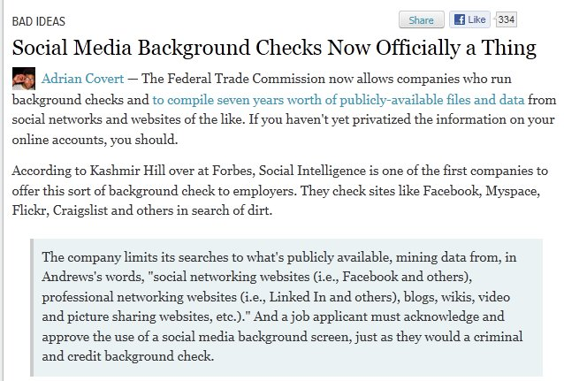
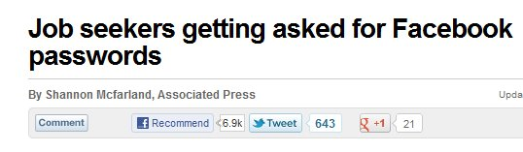

Slide 16
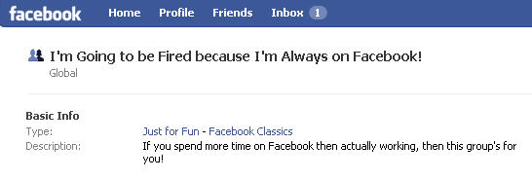
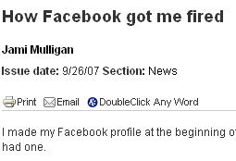
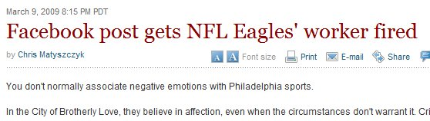
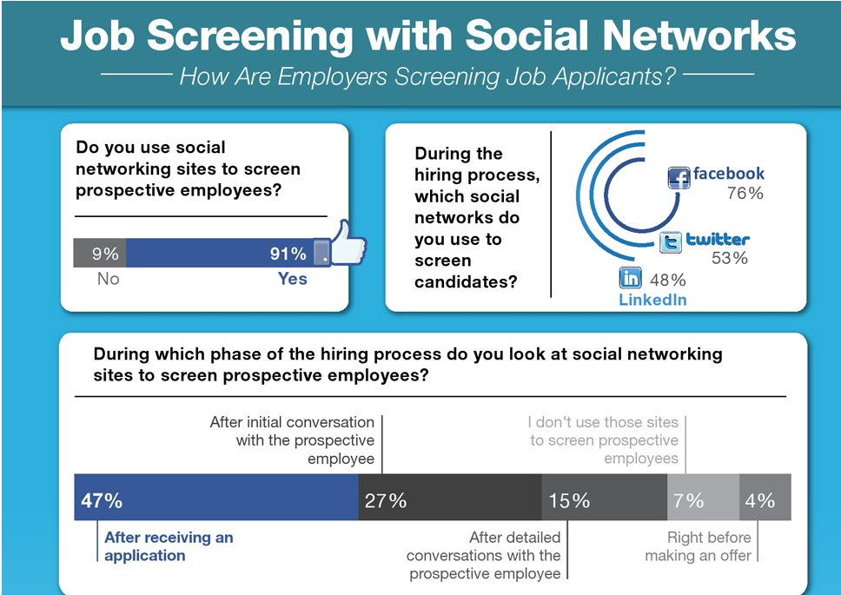
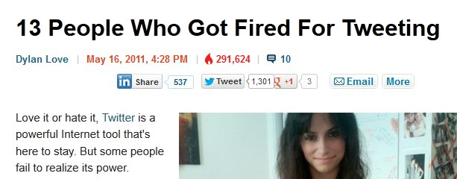
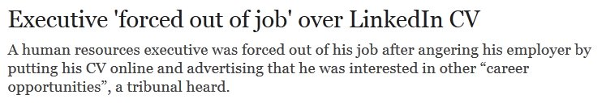

Slide 17
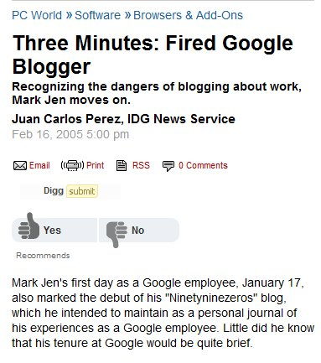


Slide 18
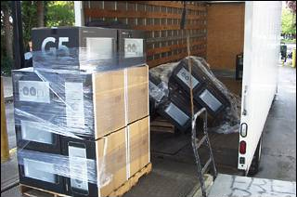

Slide 19
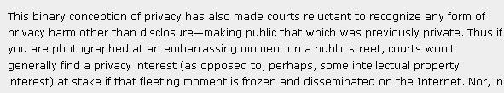
Courts won’t generally find a privacy interest

Slide 20
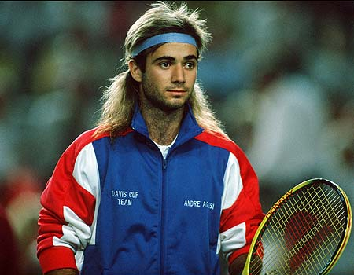
Image is Everything
Not Everything, but it does matter

Slide 21
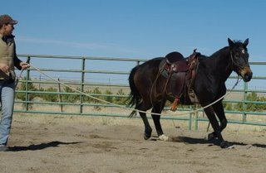

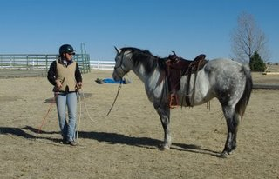


Slide 22
Resumes
1-2 pages (resume, CV may be longer)
Lists of keywords at the end, but technologies in descriptions
Make the resume human readable
  Organize
  Clear headings
  Identity info, current job, last job are most looked at.
Include branding links to blog or promotional posts and profile
Be professional
  Be relevant
  Don’t be funny (Weird Things on Resumes)
Include some Contact Information

Slide 23
Cover Letters
This is the first impression
Customize for each company
  How to write one?
    Google search
    Practice (get feedback)
  How not to write one?
    http://www.bradmcgehee.com/2010/03/how-not-to-write-a-resume-cover-letter/

Slide 24
How to stand out?
Profiles
Networking
Volunteer
Research
Be a Leader
Blog
Publish
Speak
Can be Internal or External

Slide 25
Online Profiles
A digital representation of who you are
The details of your career
  A central repository of your work
  A portfolio for clients
  Tie together the various places where you have a presence.
Online Resume
  Can be a summary or your CV
  Include the information that has “rolled off” your resume.

Slide 26
Online Profiles
Give “them” one
  They’ll find one anyway
Be prepared to explain any you have created
  Maybe some you haven’t
Be professional
  You can have fun, but keep it separate
  ALL your actions reflect on you
  Use “THE Test”

Slide 27
Online Profiles
Building an online profile
  Your own web site
  Facebook
  LinkedIn
  Plaxo
  MySpace
  Twitter
  Blogger/Wordpad/Typepress/other
Include Contact Information
  Avoid Identity Information
Keep this professional
  Use another profile for personal information

Slide 28
Online Profiles
Google Alerts
  Monitor what is being posted about you
Have this profile ready at all times
  This can be the first place you point people
Update this quarterly
Summarize all your accomplishments in one place

Slide 29
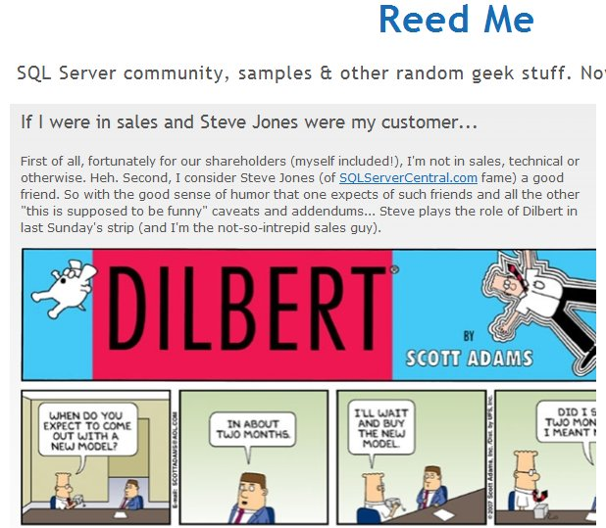

Slide 30
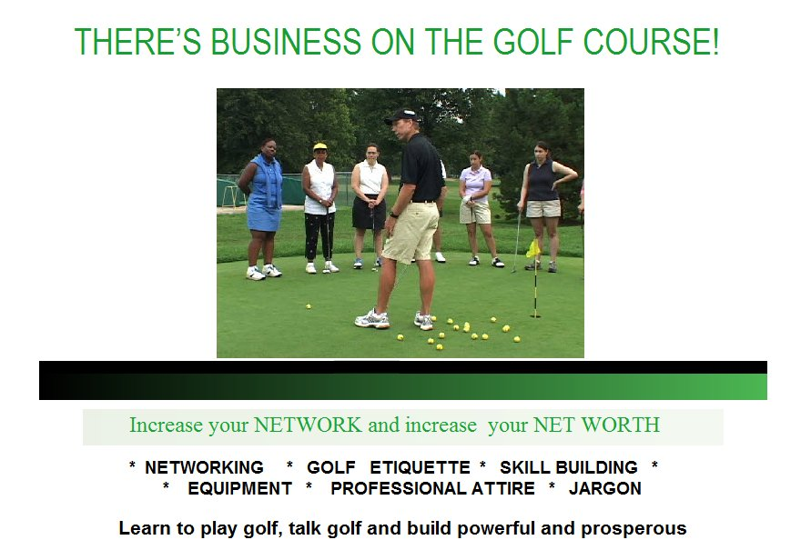

Slide 31
Networking
Business relationship building
A way to let others know about
  What you are engaged in
  Your current status
A way to hear about Opportunities

Slide 32
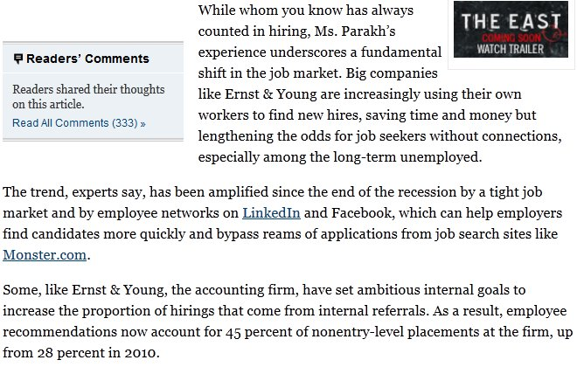
Networking
From http://www.nytimes.com/2013/01/28/business/employers-increasingly-rely-on-internal-referrals-in-hiring.html?ref=todayspaper&_r=2&

Slide 33
Networking
You’ve signed up, now what?
Interact with others
  Ask questions
  Post comments in your work, of your learning
  Survey others for their thoughts
  Get inspired
  Cheer others

Slide 34
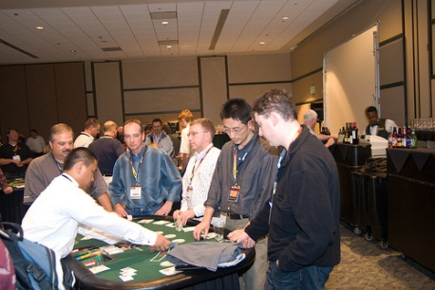

Slide 35






Social Networking

Slide 36
Social Networking
Web 2.0 / Social Networking
No different from the real world
  Chamber of commerce
  User groups
  BBB
Online world can take the place of offline
You can still participate in offline events
  Use online to reinforce your offline efforts.
  #sqlhelp

Slide 37
Social Networking
Avoid identity information
  Check with your family
Keep these interactions professional
  Use another account for personal information
Use an email that you can monitor.
Update this on a regular basis
  Use this to interact with others
  Every 2-4 weeks
Get email updates on a reasonable schedule

Slide 38
Volunteer
PASS/Local Group
  Be sincere
  Be sure your name is out there
  Document your efforts
Work
  Tackle something that needs to be done
  Be sure this is noted somewhere, like the intranet, company newsletter, etc.
  Keep a record for your review.

Slide 39
Volunteer
Forums
  Help others by answering questions
  Pay it forward
  Force yourself to learn more/check yourself
  Note your username on your resume
Build a Project (Codeplex)
Non-Profit Organizations
  Could be technical or nontechnical
Don’t volunteer unless you want to

Slide 40
Research
Ask questions your online
  Can be added to your blog with back story, thought process, your efforts
  Shows you are learning and unafraid to ask for help.
  Shows that you know how to find help
    Useful in an interview (stories)

Slide 41
Leadership
Everyone needs leaders
Leader != Manager
  But it helps
You can be
  Project leader
  Organization leader
  Thought leader
This does not have to be in technology!
  Document your efforts

Slide 42
Blog Survey
Who has a technical blog?
Who reads technical blogs regularly?

Slide 43
Blog Survey
Who has a technical blog?
Who reads technical blogs regularly?
10% have technical blogs
80% read blogs

Slide 44
Blogging
A chronicle
This is a your voice
Write about what you
  Learn
  Know
  Solve
  Do
  Think

Slide 45
Blogging
Don’t over think it. Tackle small, discrete items
Ignore similar posts
Remember this is about YOU!
  Building a publishing platform is a different blog. You can do this, but you do not have to.
A long term chronicle of your career.
Keep this blog professional
  Relate it to your career

Slide 46
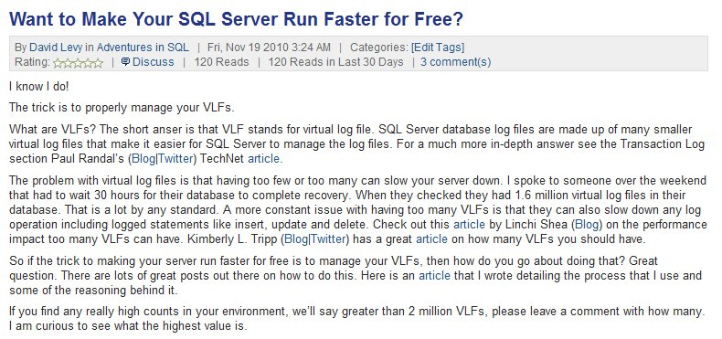
http://www.sqlservercentral.com/blogs/adventuresinsql/archive/2010/11/19/want-to-make-your-sql-server-run-faster-for-free_3F00_.aspx

Slide 47
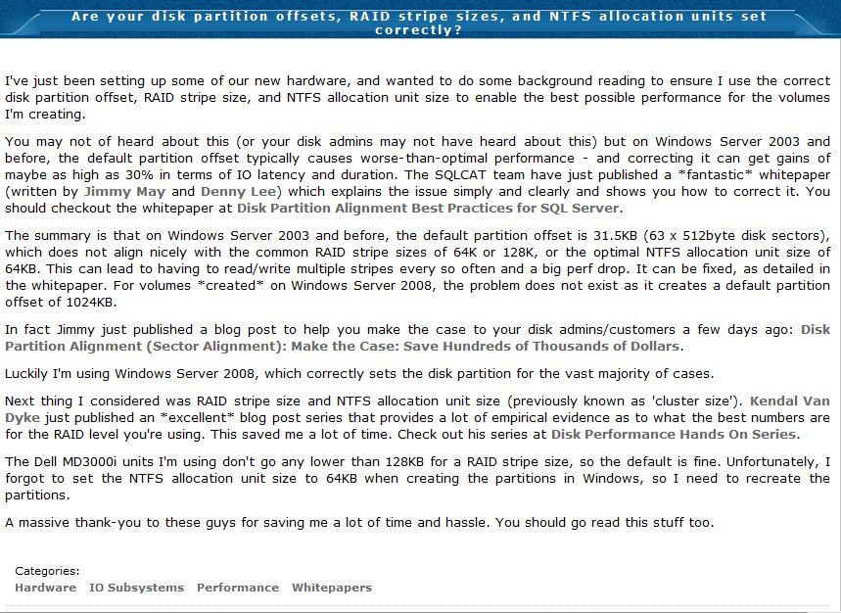
http://www.sqlskills.com/BLOGS/PAUL/post/Are-your-disk-partition-offsets-RAID-stripe-sizes-and-NTFS-allocation-units-set-correctly.aspx

Slide 48
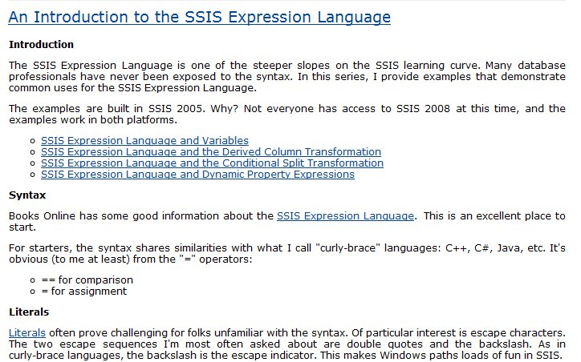
http://sqlblog.com/blogs/andy_leonard/archive/2009/01/30/an-introduction-to-the-ssis-expression-language.aspx

Slide 49
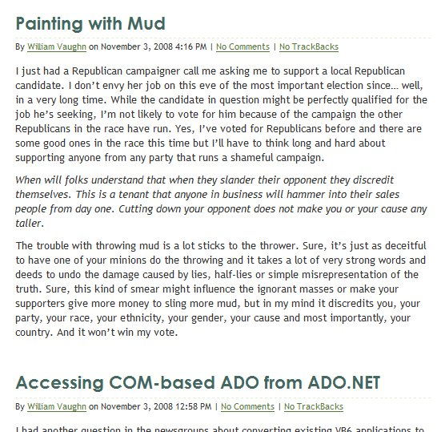
A Mistake
Politics
Development

Slide 50
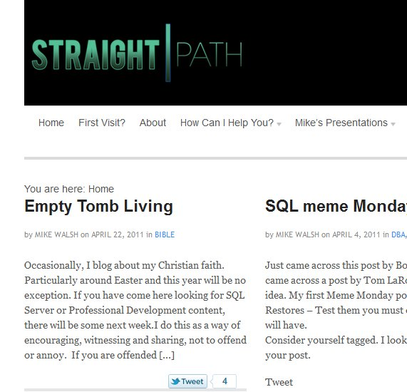

Slide 51
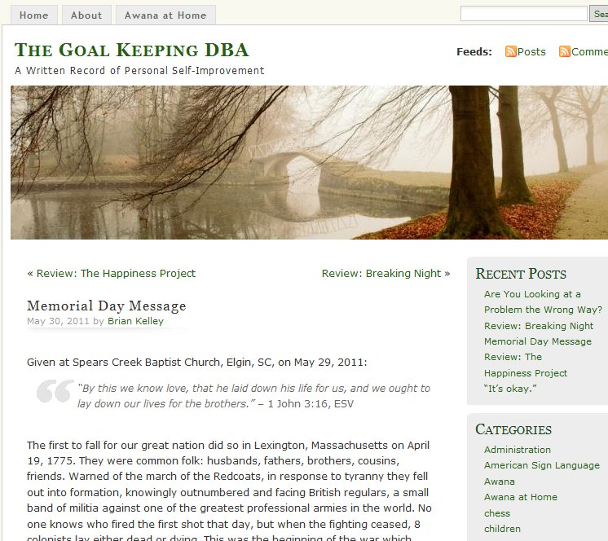

Slide 52
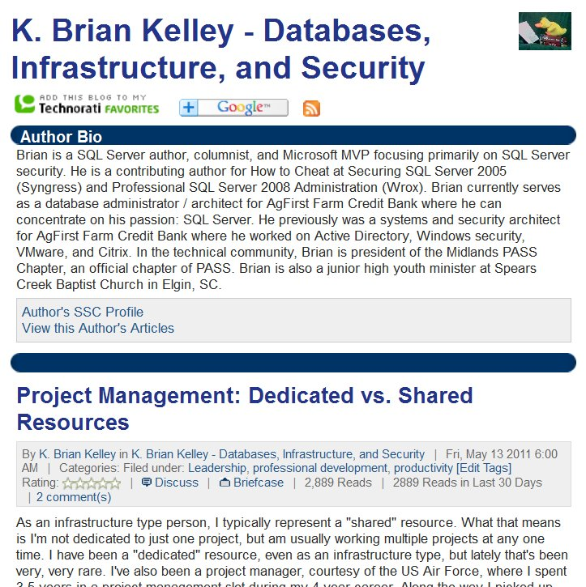

Slide 53
How to blog
Get Permission
Be smart
  Don’t disclose financial information
  Keep company secrets secret
Be consistent
  Pipeline and schedule (surveys of hiring managers show they tend to look at 5-10 posts)
Be Good
  Get Feedback from friends/spouse/co-worker

Slide 54
How to blog
Don’t copy other posts
Don’t copy other posts
Don’t copy other posts
Do your own research
Link to others and give credit
Keep a record
  Use Blogger/Word Press/Typepad
  Use Word if you want more privacy
Live Writer is great

Slide 55
Authoring / Publishing
Become a teacher
Think “Essay”
  Focus, focus, focus
  Tell the reader, give details, summarize
Don’t be intimidated
More formal writing and editing required.
  This is a step above blogging.

Slide 56
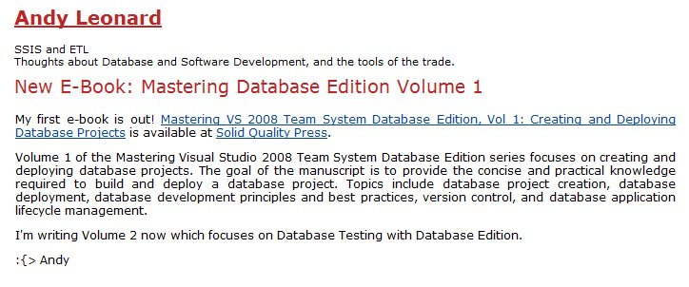
Books
Long projects
  Don’t start here. Get practice with articles or lots of blogs
Lots of authors subcontract out
  Social networking can help you find these
Promote it

Slide 57
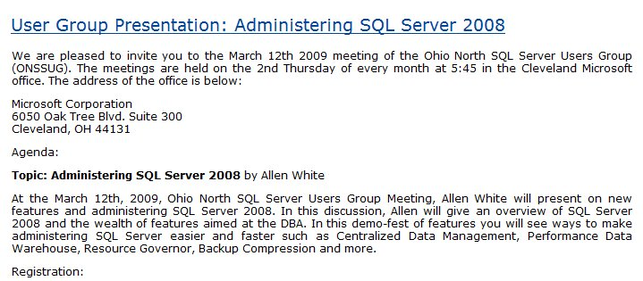
Speaking
Everyone can do this
Promote it online
  Market on your blog (or others)
  Support with downloads
  Make sure there is a permanent URL

Slide 58

Documentation
Document everything.
  Never know when you’ll need something
Don’t clutter your resume
  But have links available
  Or an online CV
Document mistakes
  Let them know you’re not that guy:

Slide 59
Recruiters
A great source for you job hunt
Many jobs go through recruiters
Non-Exclusive
Make sure they have you branding information in a profile

Slide 60

Balance
You can have a life and still do this
Work at a pace that fits your life. The key is to keep working.

Slide 61

The End
Touch your resume every quarter
Set a reminder for 6 months from today and look back
If you find something that works, send me a note
Questions?
Career Forums at www.sqlservercentral.com/forums
www.themodernresume.com
# 66

Slide 62
Links
The Modern Resume blog – Weekly notes based on this presentation and new information.
Salary Negotiation: 32 Job Pay Tips - Focuses the job negotiation lens on the 32 salary negotiation tips for IT professionals. Includes exercises and questions to assist in preparation.
Examples of Interview Questions – Good general list of questions
The First Step is to Start – Motivational post.
Crazy Things People Put on Resumes – Don’t include these things
Recruiters screening candidates - http://mashable.com/2011/10/23/how-recruiters-use-social-networks-to-screen-candidates-infographic/
What Recruiters Look At During The 6 Seconds They Spend On Your Resume - http://www.businessinsider.com/heres-what-recruiters-look-at-during-the-6-seconds-they-spend-on-your-resume-2012-4?utm_source=twbutton&utm_medium=social&utm_campaign=careers#ixzz1raRsvWA6

Slide 63
References
Will You Get Fired Because of Facebook - http://personalweb.about.com/b/2009/02/27/will-you-get-fired-because-of-facebook.htm
Steve Jones of the Sex Pistols - http://superbandgallery.blogspot.com/2009/07/steve-jones-giutars-of-sex-pistols.html
Tortoise and Hare - http://littlehealthycompetition.blogspot.com/2012/02/are-you-tortoise-or-hare.html
Asking for Facebook Passwords - http://www.usatoday.com/tech/news/story/2012-03-20/job-applicants-facebook/53665606/1
Social Media Checks - From: http://gizmodo.com/5813829/if-you-agree-to-a-social-media-background-check-your-public-info-could-sit-in-a-file-for-7-years
Career Builder Social Media Report - http://www.careerbuilder.com/share/aboutus/pressreleasesdetail.aspx?id=pr691&sd=4%2F18%2F2012&ed=4%2F18%2F2099
In Hiring, a Friend in Need Is a Prospect, Indeed - http://www.nytimes.com/2013/01/28/business/employers-increasingly-rely-on-internal-referrals-in-hiring.html?ref=todayspaper&_r=2&
What is business networking - http://www.entrepreneur.com/article/196758
The Ghost Who Codes - http://www.troyhunt.com/2013/02/the-ghost-who-codes-how-anonymity-is.html

